Slide 1
Topic – implementation of quantum K-means algorithm using Manhattan distance approach Presenter Name – Anshuman Banik Dept. of Instrumentation and electronics, Jadavpur University

Slide 2
Contents
Why Manhattan distance approach is required
How to Compute the Manhattan distance
Implementation of the Quantum k-means algorithm using the Manhattan distance based approach
Cirq implementation of the quantum circuit
Python simulation for the circuit

Slide 3
Necessity of the Manhattan approach
The Quantum K-means algorithm utilizes the Euclidean distance approach as a straightforward technique for clustering qubits into distinct groups. However, it is not efficient enough to be used in certain cases. Some of those cases are as follows :
Path information between cities - The Euclidean distance is based on the assumption that the distance between two points is a straight line. However, when considering the path information between cities, where roads can be curved and winding, the Euclidean distance may not provide an accurate representation of the actual travel distance.
Presence of Obstacles - When faced with obstacles like buildings, mountains, or other physical barriers that separate two data points, the Euclidean distance measure fails to consider the requirement of maneuvering around these hindrances.
Network routing in Communication systems - In communication systems involving data transmission across a network, the Euclidean distance may not provide an accurate measure of the true cost or latency of the transmission. This is because the Euclidean distance fails to take into account the intricacies of network topology and routing.
Non-continuous Feature spaces - The Euclidean distance metric is designed for continuous feature spaces, making it unsuitable for cases where features are categorical or discrete. In situations involving text data or other categorical attributes, alternative distance measures such as cosine similarity are commonly favored.
Therefore, it is evident that the Euclidean method proves to be ineffective in the aforementioned scenarios. Consequently, a more adaptable approach is required to address some of the exceptional cases and consequently enhance the utilization of the Qmeans.

Slide 4
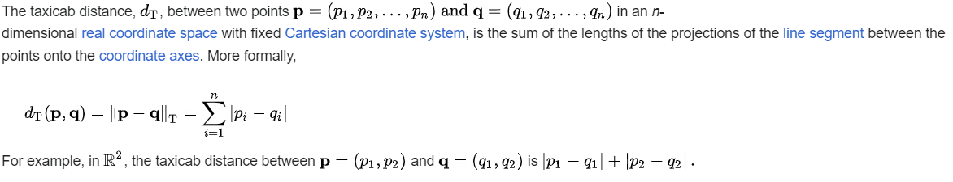
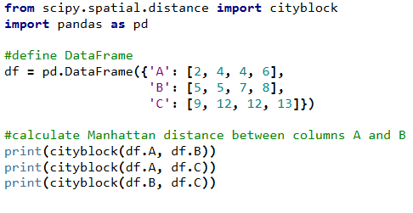
Computation of the Manhattan distance
Manhattan Distance/Taxicab Distance/City Block Distance is a widely used distance metric in the regression analysis techniques. It is defined as the sum of the absolute difference of their cartesian coordinates.
Advantages of the Manhattan distance over Euclidean distance –
Less sensitive to larger deviations/outliers in data.
Computationally efficient and extra suited to some data types.
High interpretability

Slide 5
One of the basic differences between the Euclidean Q-means and Manhattan Q-means is that, in the case of Euclidean Q-means we have used “Swap test” to compute the convergence between 2 qubits which in turn provides a fair approximation about the probabilistic overlap between them and hence, gives us the Euclidean distance. But in case of Manhattan Q-means, there is no such “Swap test” and we have to perform proper vector operations via a quantum circuit called “Cal” in order to approximate the required overlap.
There are 2 major steps involved in this computation –
Initialization – The number of clusters k and the initial centroids are decided.
Main loop() – The clusters for each training vectors are determined via repeated computations.

Slide 6
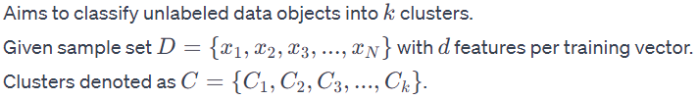
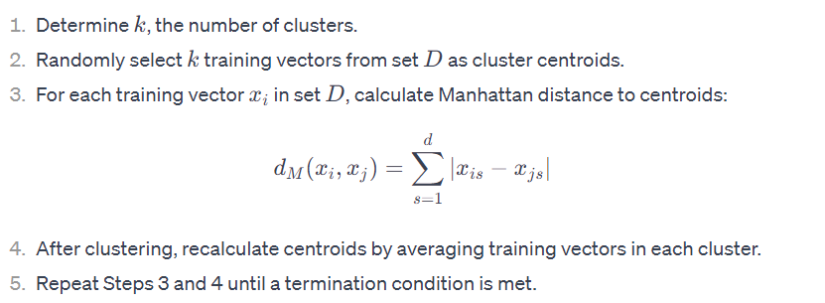
Qmeans implementation
Algorithmic features –
Simple and easy to implement
Dis-advantage: Slow convergence
Complexity: O(Nkd)

Slide 7
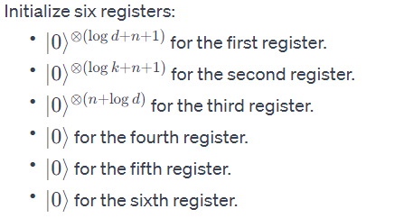
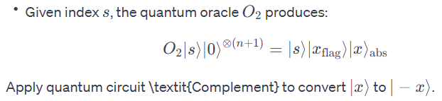

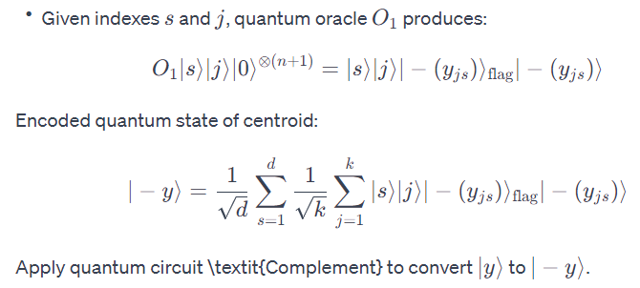
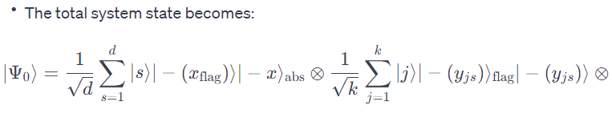
Initialization –

Slide 8
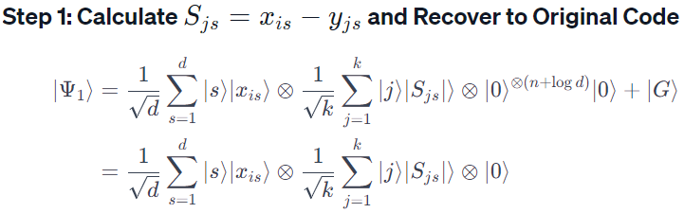
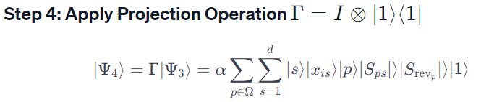
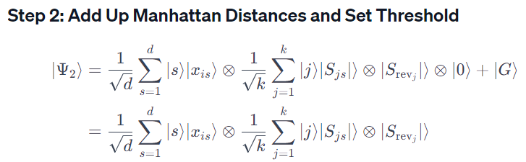
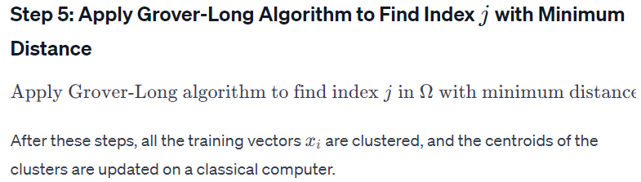
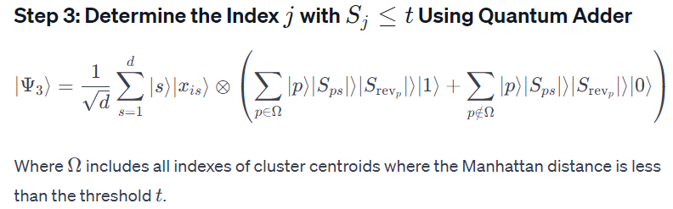
Main_Loop()

